Slide 1

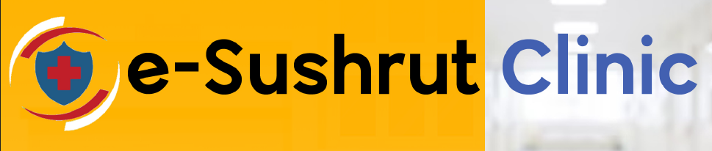
A SaaS Based Solution to Clinics, Nursing Homes, Pharmacies & Labs

Slide 2
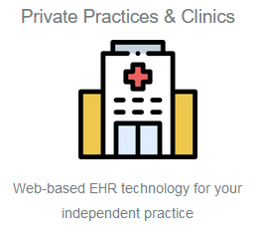
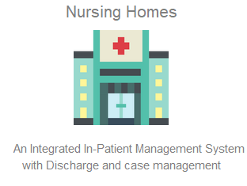
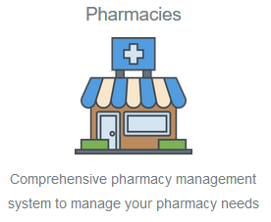
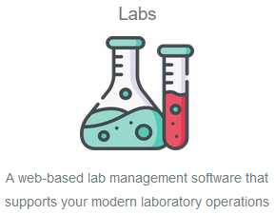
SaaS solutions to Variety of Users:
A. E-Clinics (OP) | B. Nursing Homes (IP) | C. Pharmacies | D. Lab Management
ABDM M1-M2 Enabled Patient Appointment Patient Registration Patient Billing (OP) OP Consultation and triage Patient Flow Management Doctor-Patient SMS/emails Detailed EMR Doctor/Patient Portals OP Billing | Admissions Management Patient Monitoring IPD Nursing Desk E-Discharge E-Doctor Desk Patient Record Management Bed Management Case-Sheet Management Disease Management IP Billing UPI and other modes payment Integration | Token Based ABHA System Asset Management Configurations Indent & Acknowledge Stock Quantity Adjustments Issue to patients Issue to sub-stores/Wards return from Patients/Sub-stores Invoicing, billing Reports like stock in hand, near expiry, reorder level, etc. | Sample Collection, Acceptance, Packing List Generation Test Scheduling & Billing Graphical reports Sample processing (auto barcode generation and printing, label printing; sample assertion, sample source, sample/specimen condition, sample recollection) Test Result Entry / Interface with Uni/Bi-Directional Equipment Signoff Reports

Slide 3

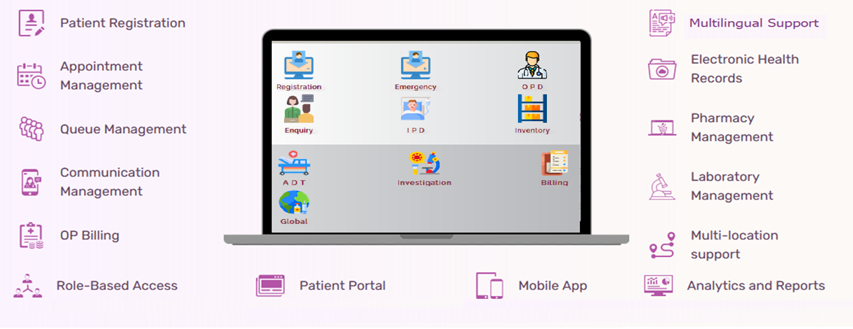
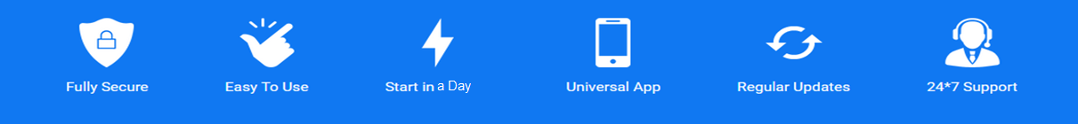
Key Features of e-Sushrut@Clinic

Slide 4
USP of the technology
Seamless Configuration & Smooth Onboarding : User-friendly interface and intuitive setup options allow clinics to quickly customize the software to match their specific requirements without extensive technical knowledge. & Offers a guided onboarding process, including training and support.
ABDM and Health Standards: Adheres to ABDM features and other Major health standards, ensuring data consistency, accuracy, and compatibility with industry norms.
Mobile-Friendly: Provides a responsive design that adapts to various devices, enabling healthcare professionals and patients as well to access critical information on PCs, smartphones, tablet even works offline with limited features.
Secure Data Exchange: Facilitates secure data exchange and interoperability with other healthcare systems, supporting data sharing while maintaining patient confidentiality and data integrity.
Scalability: Easily scales to accommodate growing clinics, additional modules, and increased patient loads, ensuring long-term suitability for varying needs.
Success Stories/Client Names (noteworthy deployments)
AAM Admi clinics (600+ Mohalla clinics) with daily 25000+ patients with Digital registration, Prescription, Electronic records, Drug Dispensing etc.
NHPC Health facilities (24):L with daily 400+ patients with Digital registration, Prescription, Electronic records, Drug Dispensing etc.

Slide 5
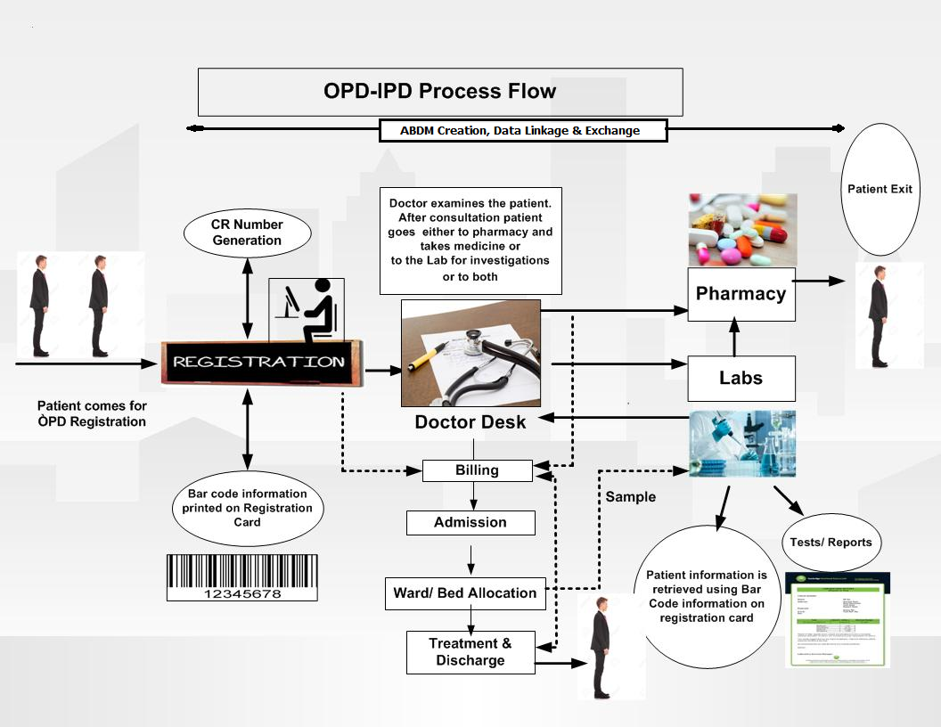
eSushrut@Clinic Digital Workflow

Slide 6
Subscription (Customer)
Research and Evaluation
Sign Up and Registration
1st Level Verification
Payment and Subscription
Order confirmation by CDAC
Configuration and Customization
Data Migration / API Integration (if any)
Training Onboarding
Go-Live &
Ongoing Support

Slide 7
On-boarding Process (CDAC-Team)
Customer: Plan Selection and Order Placement
Customer Information and Billing Details
Payment Processing
Order Confirmation
Account Creation or Activation wrt Plan
Invoice Generation &
Plan Commencement
Recurring Billing
Renewals and Reminders
Upgrades or Downgrades & Support

Slide 8
Platform Administration
User Management
Application Settings and Configuration
Notifications & Alerts
Support and Documentation
Integration
Subscription Management & Invoicing
Data Management
Reporting and Analytics
System Monitoring and Performance
Compliance and Security
Communication Management
Payment Gateways & Customer Accounts

Slide 9
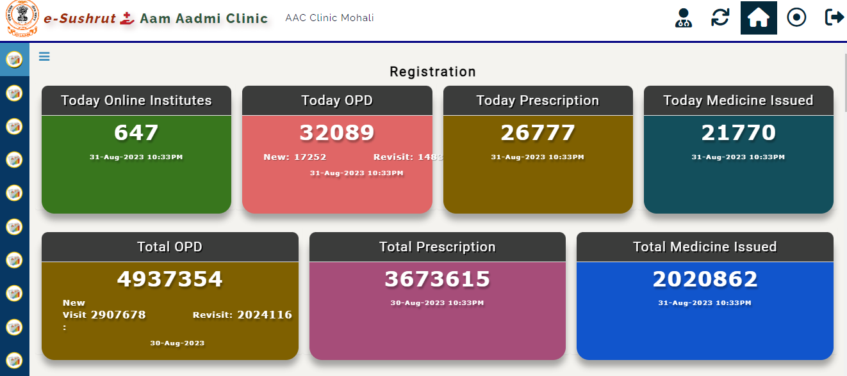
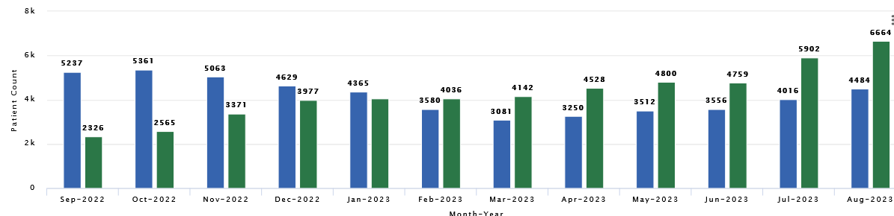

Slide 10
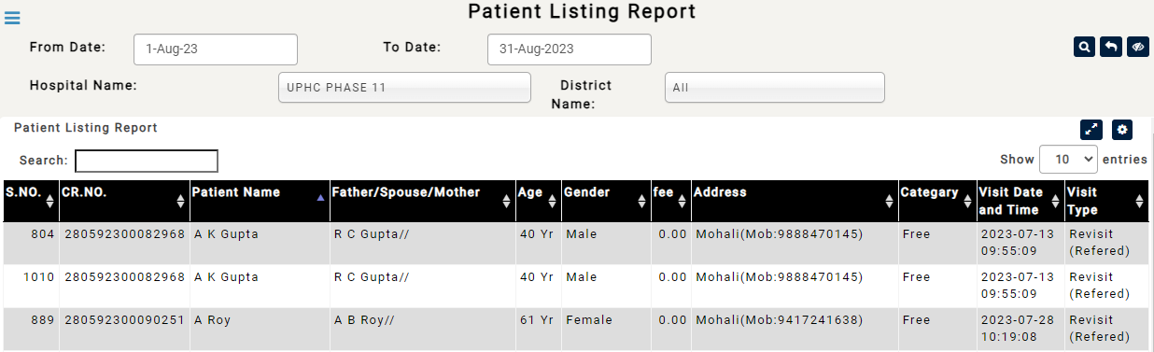
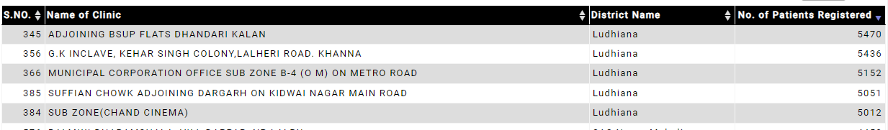

Slide 11
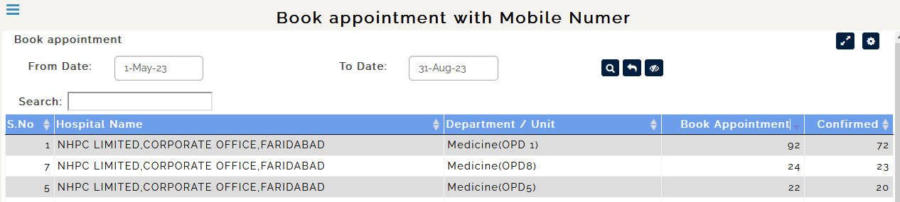
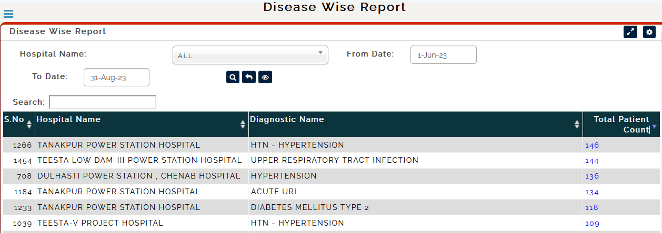

Slide 12
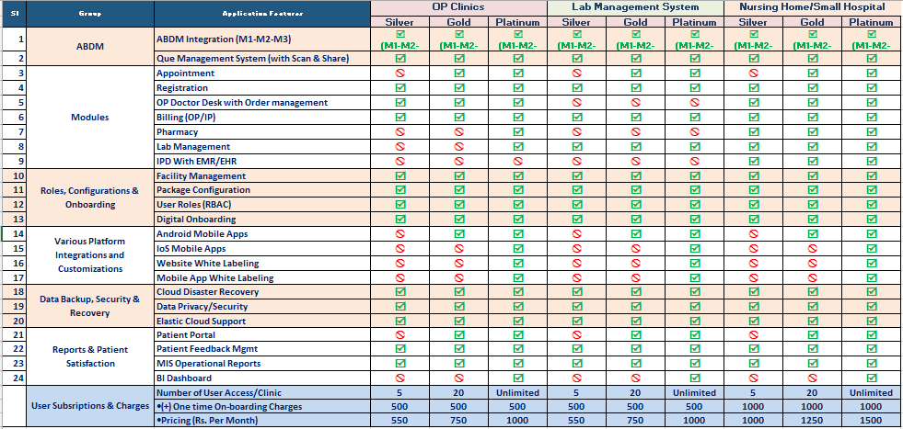
Subscription Plans (Site)

Slide 13

Contact:
Ashutosh Pandey | +918285527858 | helpdesk@ehmis-lite.in
https://muhseclinic.uat.dcservices.in

